Slide 1

Computer Organisation and Architecture
Chapter 1
Introduction

Slide 2
    Chapter Contents
  1.1 A Brief History of Computing
  1.2 The Von Neumann Model
  1.3 The System Bus Model
  1.4 Levels of Machines
  1.5 A Typical Computer System
  1.7 Organization of the Book
  1.8 Case Study: What Happened to Supercomputers?

Slide 3
  • Computer architecture deals with the functional behavior of a computer system as viewed by a programmer (like the size of a data type – 32 bits to an integer).
  • Computer organization deals with structural relationships that are not visible to the programmer (like clock frequency or the size of the physical memory).
  • There is a concept of levels in computer architecture. The basic idea is that there are many levels at which a computer can be considered, from the highest level, where the user is running programs, to the lowest level, consisting of transistors and wires.

Slide 4

Wolf Radius Bone
  • Wolf radius bone ca. 25,000–30,000 B.C. showing 55 cuts in groups of five, suggesting a rudimentary form of multiplication or division.
  earliest known counting aid
  the first form of data recording -- Introduced the idea of representing quantities physically
(Source: Illustrated London News, October 2, 1937.)
Notes:
Notches on objects – counting @ tallying
Why group of 5? Counting using fingers

Slide 5
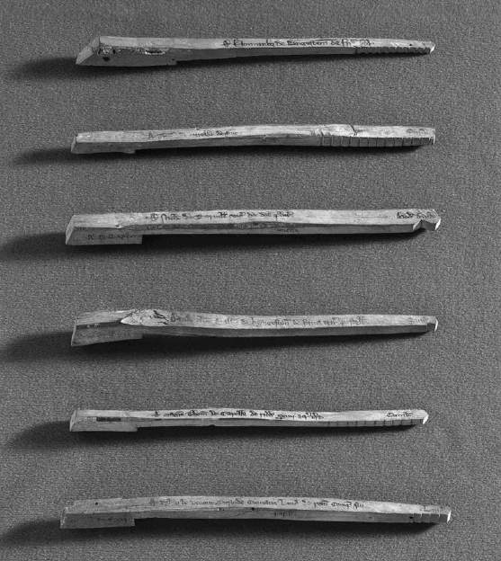
Tally Sticks
  • Original wooden tally sticks from Westminster, England, ca. 1250–1275 A.D.
  Improved on the tally bone with practical data storage and verification.
  data recording for human transactions — an early “database.”
(© SSPL/The ImageWorks.)
Notes:
Similar to knots in cord, pebbles in bags, beads on wire
What is Tally Sticks?
A form of receipt that can be traded & sold, similar to loan
Cuts indicate amount, size (larger for payee, small for payer)
Security – no two sticks split exactly the same way, eliminate forgeries

Slide 6
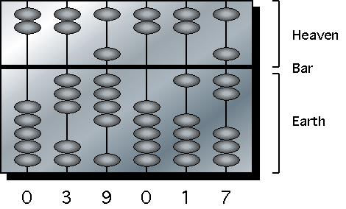
Chinese Abacus
  • Representation of 39,017 on a Chinese abacus.
  A manual calculating device (~2000 BCE) using beads to represent digits.
  manual computation (addition, subtraction, multiplication, division).
Notes:
0 – both earth & heaven away from bar
1,2,3,4 – raise earth beads accordingly
5,6,7,8,9 – lowered heaven beads + raise earth beads accordingly

Slide 7
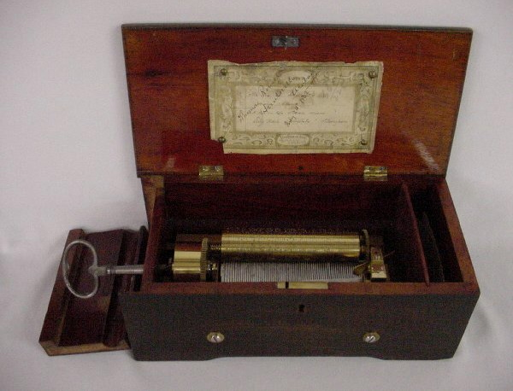
Cylinder Music Box
  • Victorian Swiss cylinder music box, dated 1862.

Slide 8
Cylinder Music Box
  • Victorian Swiss cylinder music box, dated 1862.
  One of the first examples of data-driven mechanical automation.
  cylinder encoded instructions (music notes), just like programs store instructions for a computer.

Slide 9
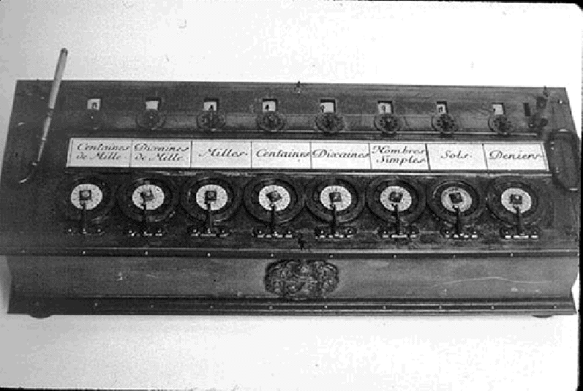
Pascal’s Calculating Machine
  • Performs basic arithmetic operations (early to mid 1600’s). Does not have what may be considered the basic parts of a computer.
  One of the first automatic mechanical calculators.→ Replaced manual counting with mechanized computation, a key step toward automation.
(Source: IBM Archives photograph.)
Notes:
Pascal calculator – Pascaline

Slide 10
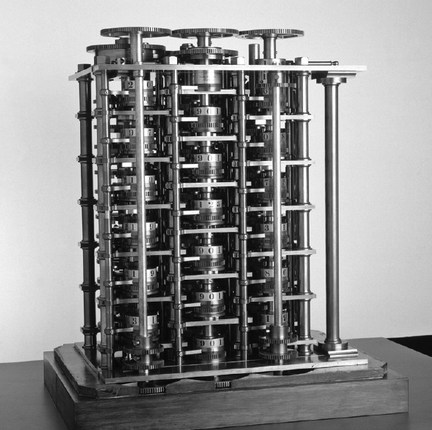
Babbage’s Difference Engine #1
  • Working portion of Babbage’s Difference Engine No. 1, which is the first known automatic calculator.
  A precursor to the modern computer’s CPU and arithmetic logic unit (ALU) ideas.
(© SSPL/The ImageWorks.)
Notes:
Reason of creation – manually compute mathematical tables (used in navigation & scientific work) contained errors & inaccuracies.
Why #1, cos this is 1/7 of the proposed machined (never completed)
Functions,
read input data
store data
perform calculations
produce output data
control machine operation
Difference Engine (to evaluate poly based on finite diff.) leads to Analytical Engine (based on Jacquard Pattern Weaving Loom)

Slide 11
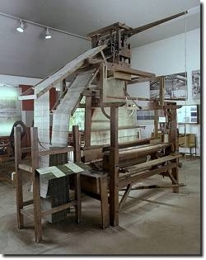
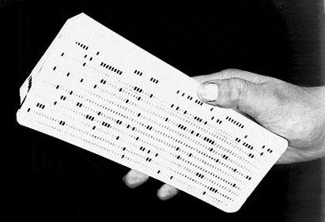
The Jacquard Pattern Weaving Loom
  • The Jacquard pattern weaving loom (ca. 1804).
  The punched card was an early form of programmable input.
(Source: The Deutsches Museum.)
Notes:
More sophisticated – mechanism for making decision (branching) + programming using punched cards
Analytical Engine could not be built due to lack of technology.

Slide 12
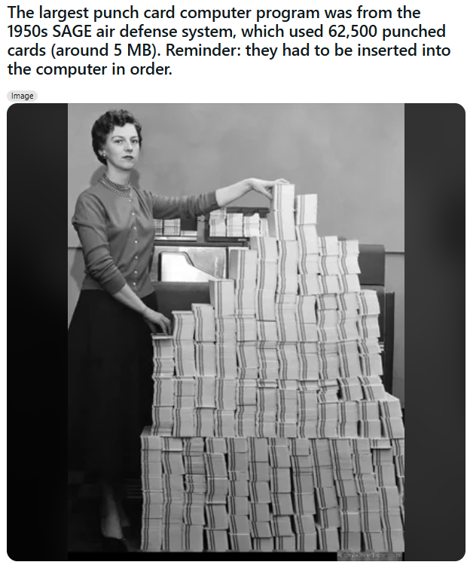


Slide 13
https://www.i-programmer.info/history/people/10030-margaret-hamilton-apollo-and-beyond.html?start=1

Slide 14
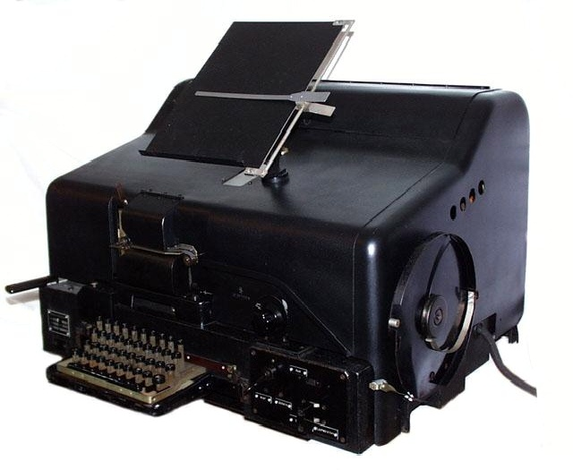
Enigma
  • Siemens Halkse T-52 Sturgeon (Enigma) cipher machine.
  A German cipher machine used during WWII to encode and decode messages.
  Demonstrated machine-based logic and encryption.
  Logical computation and early computer design.
(Photo and copy courtesy John Alexander, G7GCK Leicester, England.)
Notes:
Computing thrust – due to war (WW2)
Encryption machine used by Germany.
The creation of code breaking machine by Alan Turing, English mathematician from Bletchley Park.

Slide 15
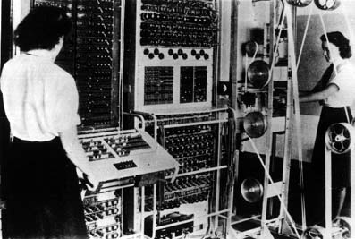
Colossus
  • The Colossus (ca. 1944).
  The world’s first programmable electronic computer, built to break Enigma codes.
(Source: http://www.turing.org.uk/turing/scrapbook/electronic.html.)
Notes:
To crack Lorenz encoding.
Uses vacuum tubes to store contents (from paper tape) and perform computations. Programming by plug boards.

Slide 16
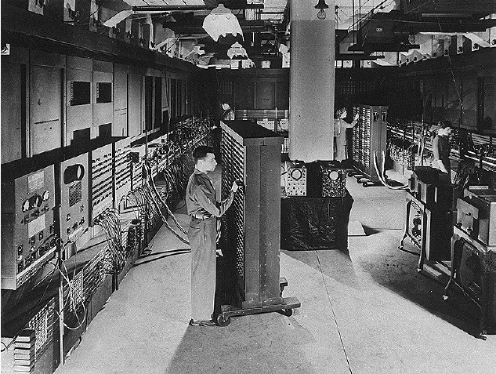
The ENIAC
  • First general-purpose electronic computer (U.S. Army project).
  Could be programmed for different tasks using switches and cables.
  Fully electronic computing.
(Time & Life Pictures/Getty Images.)
Notes:
ENIAC (Electronic Numerical Integrator & Computer) – use to compute ballistic trajectories for US Army.
Consist of 18,000 vacuum tubes.
Programming & data entry by switches & cables setting.
NO stored program.
NO central memory unit.
Significant development,
Transistors
Invented in 1947 by AT&T Bell Labs, replacing vacuum tubes
Called solid state device (based on solid state physics which deals with crystal)
Runs on low power, reliable and less expensive
Integrated circuit (IC)
Developed by both Texas Instruments (1958) & Fairchild Semiconductor (1959)
Fabrication of multiple devices (transistors, resistors & capacitors) on the same crystal in a single packaged component.

Slide 17
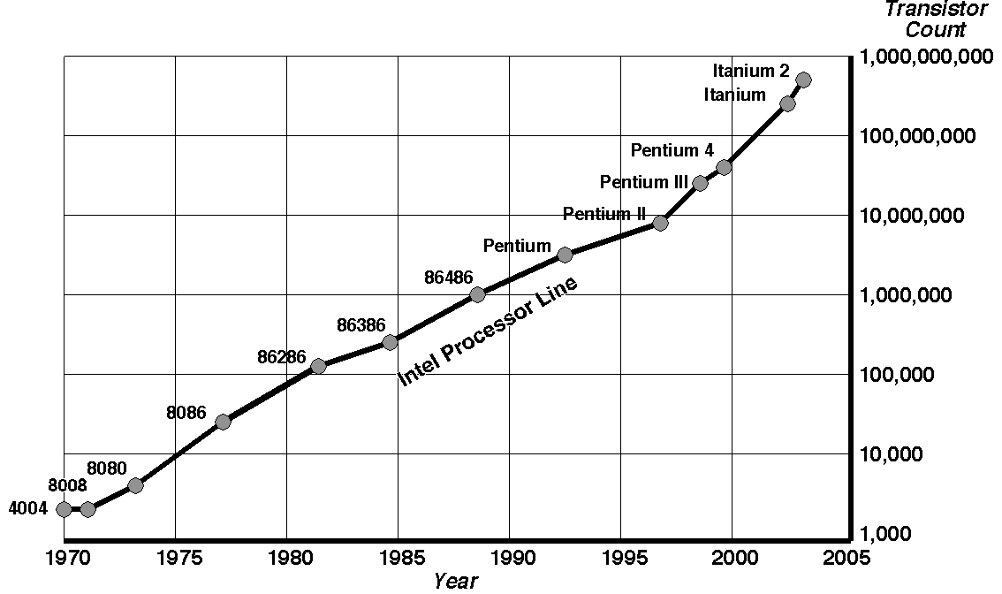
Moore’s Law
  • Computing power doubles every 18 months, for the same price.
Notes:
Who?
Gordon Moore, founder of Intel
Stated in his paper entitled "Cramming more components onto integrated circuits", Electronics Magazine 19 April 1965

Slide 18
From simple counting tools to programmable electronic machines
a step toward automation, memory, and programmability
Counting (Wolf Bone → Tally Sticks)
Representing numbers physically.
Manual Calculation (Abacus)
Assisting arithmetic.
Mechanical Automation (Music Box → Pascaline → Difference Engine)
Machines doing repetitive work automatically.
Programmability (Jacquard Loom)
Instructions stored as data (punched cards).
Logic and Electronics (Enigma → Colossus → ENIAC)
Transition to programmable, electronic, and general-purpose computing.

Slide 19
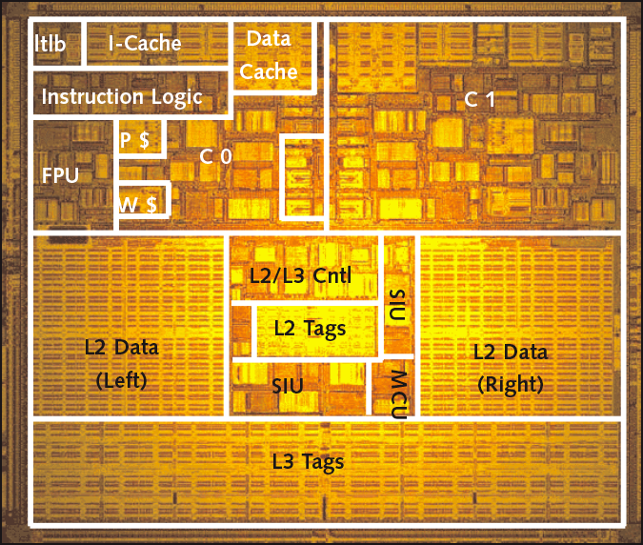
UltraSPARC IV+ Layout
  • Die photo of UltraSPARC IV+, 295 million transistors, 19.7 mm × 17.0 mm.
  microprocessor developed by Sun Microsystems (around 2005).
Notes:
(Source: “Best Servers of 2004”, Kevin Krewell, 1/18/05, Microprocessor, www.MPRonline.com, Reed Electronics Group, ref: h10018.www1.hp.com/.)

Slide 20
Key Features / Layout Components - UltraSPARC IV+ Layout
Component | Description
Dual Cores | Two independent processing units for parallel tasks
Shared L2 Cache | High-speed storage for both cores -(On-Chip Unified Cache) -- A large on-chip Level 2 cache (up to 2 MB) is shared by both cores.
Memory Controller | Manages data flow to main memory
System Bus Interface | Connects CPU to external devices
Execution Units | Perform arithmetic, logic, and floating-point operations
Interconnect/Crossbar | Handles internal data traffic between cores and cache

Slide 21
A simple layout diagram - UltraSPARC IV
+----------------------------------------------+
| UltraSPARC IV+ Processor Chip |
|----------------------------------------------|
| Core 1 | Shared L2 Cache | Core 2 |
| \ | / |
| \ | / |
| \ | / |
| Memory Controller & Bus Interface |
+----------------------------------------------+

Slide 22
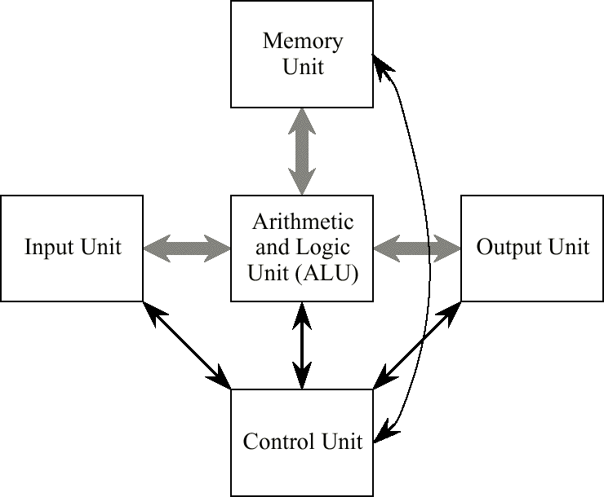
The von Neumann Model
  • classical design model of a computer system, proposed by John von Neumann in 1945.
  The von Neumann model consists of five major components:
  (1) input unit; (2) output unit; (3) arithmetic logic unit; (4) memory unit; (5) control unit.
  basis for almost all general-purpose computers today — from laptops to supercomputers.
Notes:
Basic principles of computing.
Input unit – provides instructions & data (Allow users or other systems to send data or commands into the computer -- keyboard, mouse, sensors)
Memory unit – store instructions & data (RAM in modern computers.)
ALU – process the instructions & data (Performs mathematical (add, subtract, etc.) and logical (AND, OR, compare) operations.)
Control unit – direct the ALU process (Fetches instructions from memory, decodes, and executes them -- Directs how data moves between the ALU, memory, and input/output devices.)
ALU + Control unit = CPU (Central Processing Unit)
Output unit – handle results
Thick arrows – data paths
Thin arrows – control paths
Stored program = a program is stored in the computer’s memory along with the data to be processed.
Allow the creation of compilers & operating system thus increase versatility.
“The Von Neumann Model is like a chef reading a recipe.
The recipe (program) and ingredients (data) are both written in the same book (memory).
The chef (CPU) reads one line, understands what to do, and performs it — over and over again.”
The “Von Neumann Bottleneck”
The CPU and memory share a single data bus.
This means only one transfer (data or instruction) can happen at a time.
The bottleneck limits performance because the CPU often waits for memory access.

Slide 23
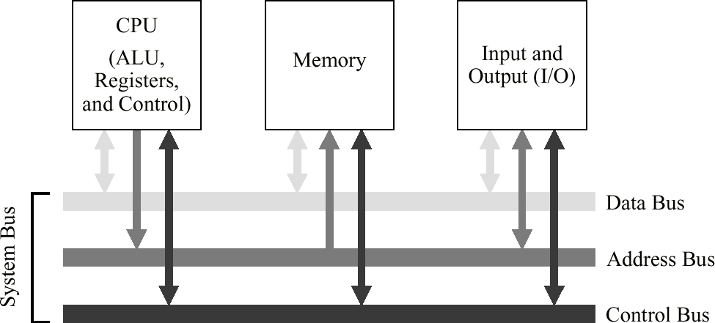
The System Bus Model
  • A refinement of the von Neumann model, the system bus model has a CPU (ALU and control), memory, and an input/output unit.
  • Communication among components is handled by a shared pathway called the system bus, which is made up of the data bus, the address bus, and the control bus. There is also a power bus, and some architectures may also have a separate I/O bus.
Notes:
System Bus Model – streamlined version of von neumann
Data bus – carries transmitted info.
Address bus – identify the origin & destination of info.
Control bus – describe the how & in what manner info is being sent
*Power bus – electrical power to the components
Physically, buses is a collection of wires that are grouped by function.
Sharing bus requires that the entities to have unique identities – addresses.
“A bus in a computer works like a road system connecting different cities.
The CPU, memory, and devices are like cities, and the bus is the road that carries vehicles (data and instructions) between them.”

Slide 24
The Three Main Types of Buses
Type | Purpose | What It Carries
Data Bus | Transfers actual data between CPU, memory, and I/O devices | Binary data (e.g., numbers, instructions)
Address Bus | Specifies the memory location or device address involved in the data transfer | Memory or device addresses
Control Bus | Carries control signals that coordinate actions among components | Read/write signals, interrupt requests, clock, etc.

Slide 25
Example of Bus Operation
When the CPU wants to read data from memory:
  CPU places the memory address on the Address Bus.
  CPU sends a “Read” signal on the Control Bus.
  The memory sends the data back on the Data Bus.
This happens millions or billions of times per second.

Slide 26
+-----------+
| CPU |
+-----------+
|
+----------+----------+
| |
Address Bus Control Bus
| |
+----------+----------+
|
+--------------+
| Memory |
+---------------+
|
+----------+----------+
| |
Input Devices Output Devices
| |
+---------- Data Bus -+

Slide 27
Modern Bus
PCIe (Peripheral Component Interconnect Express) is a type of bus,but it’s a modern, high-speed serial bus designed specifically for connecting peripheral devices to the CPU and memory.
PCIe is a communication link between the CPU (or chipset) and external devices like:
  Graphics cards (GPUs)
  Network cards (NICs)
  SSDs (NVMe drives)
  Capture or sound cards
Notes:
PCIe (Peripheral Component Interconnect Express) is the modern replacement for older bus standards like:
PCI (Peripheral Component Interconnect)
AGP (Accelerated Graphics Port)

Slide 28
PCIe Speeds (per Lane, per Direction)
Generation | Data Rate per Lane | Total for x16 (16 lanes)
PCIe 1.0 | 250 MB/s | 4 GB/s
PCIe 2.0 | 500 MB/s | 8 GB/s
PCIe 3.0 | ~1 GB/s | 16 GB/s
PCIe 4.0 | ~2 GB/s | 32 GB/s
PCIe 5.0 | ~4 GB/s | 64 GB/s
PCIe 6.0 | ~8 GB/s | 128 GB/s
x1 → |====| (1 lane)
x4 → |====|====|====|====| (4 lanes)
x8 → |====|====|====|====|====|====|====|====| (8 lanes)
x16 → |====| ... 16 total ... |====| (16 lanes)
Notes:
PCIe 1.0 supports up to x16 lanes,
but each lane is slower compared to later generations.
PCIe 1.0 supports up to x16 lanes.
“x16” = number of lanes (width).
“1.0” = generation (speed per lane).
So PCIe 1.0 x16 = 16 lanes × 250 MB/s per lane = 4 GB/s each direction (8 GB/s total).

Slide 29
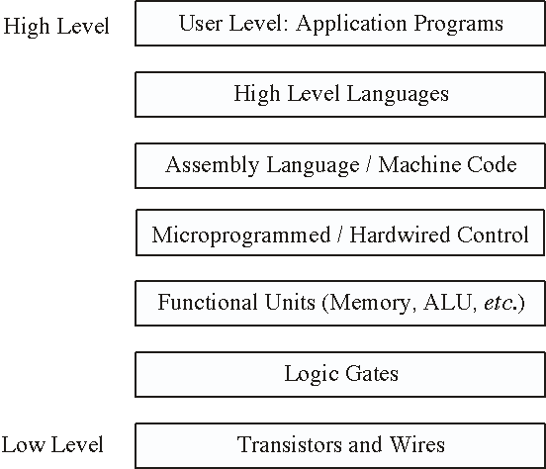
Levels of Machines
• There are a number of levels in a computer, from the user level down to the transistor level.
• Progressing from the top level downward, the levels become less abstract as more of the internal structure of the computer becomes visible.

Slide 30
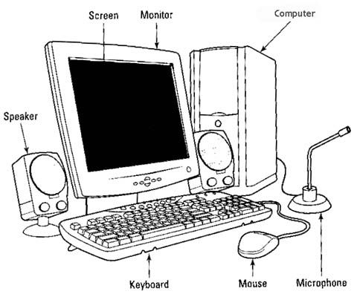
A Typical Computer System

Slide 31
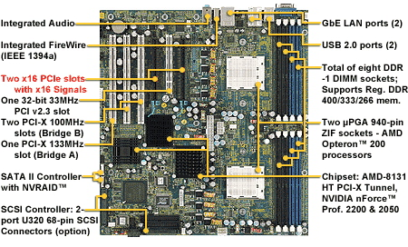
The Motherboard
  • An AMD Opteron 200 based motherboard.
Source: Courtesy Tyan Computer Corp. (USA).
Notes:
About the AMD Opteron Processor Family
Introduced: 2003 by AMD.
Purpose: Designed for servers and high-performance workstations (not regular desktops).
Architecture: Based on the AMD64 (x86-64) architecture — the first to support 64-bit computing in mainstream CPUs.
AGP (Accelerated Graphics Port)

Slide 32
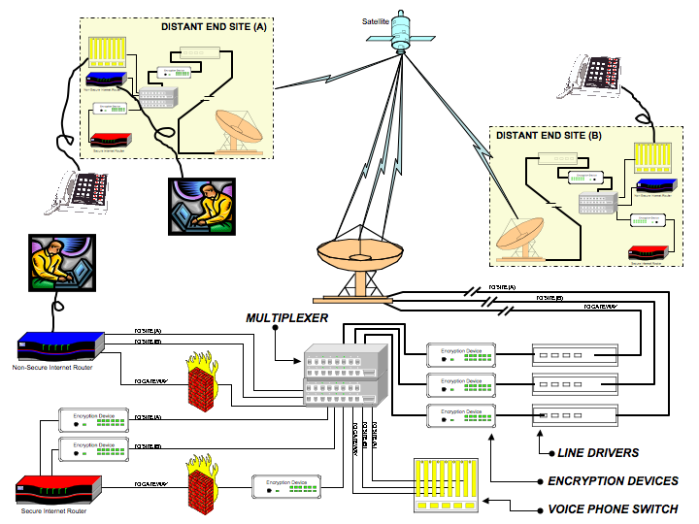
End-to-End Network
  • End-to-end communication over a network. Highlighted architectural components include computers, hubs, switches, routers, firewalls, multiplexers, and
  phone switches.
Source: MSG Scott Bramwell.

Slide 33
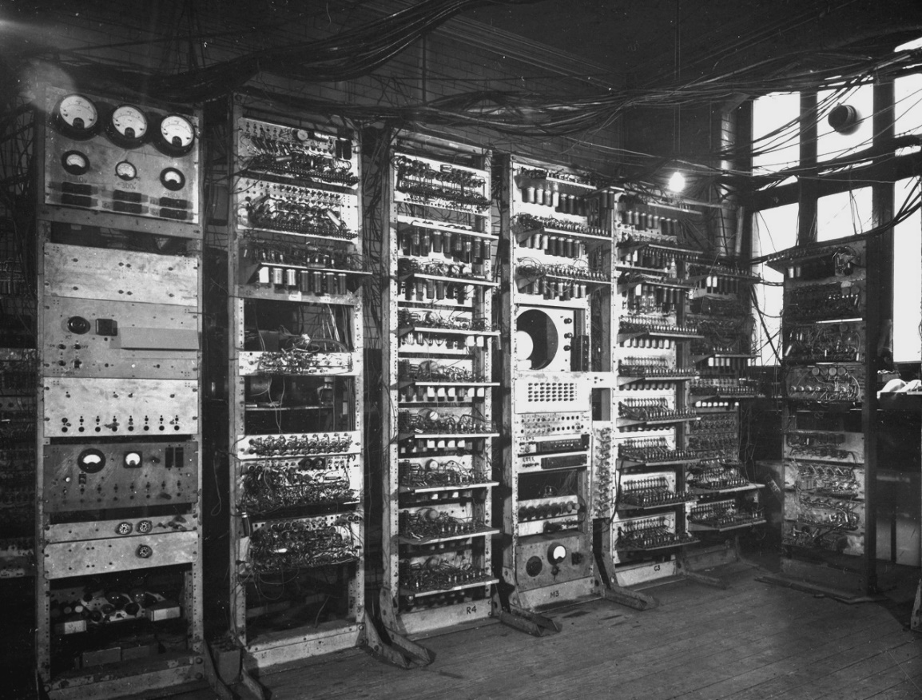
Manchester University Mark 1 / Baby
  • The Manchester University Mark 1, showing the Manchester Baby portion which was made operational on 21 June 1948.
  (Source: The University of Manchester, www.computer50.org/mark1/ip-mm1.mark1.html)
Notes:
The Baby introduced:
the stored-program concept — instructions and data kept in the same memory, which could be accessed electronically.
This design principle became the foundation of all modern computers.

Slide 34
Technical Overview - “Baby”
Feature | Description
Full name | Small-Scale Experimental Machine (SSEM), a.k.a. “Manchester Baby”
Year built | 1948
Place | University of Manchester, UK
Inventors | Frederic C. Williams, Tom Kilburn, Geoff Tootill
Technology | Vacuum tubes (valves)
Memory type | Williams-Kilburn tube (a cathode-ray tube memory)
Word size | 32-bit words
Memory capacity | 32 words of storage
Clock speed | About 1.2 kHz (very slow by today’s standards)
Arithmetic | Binary arithmetic (addition and subtraction)
Input | Manual switches
Output | CRT (Cathode-Ray Tube) display

Slide 35
Modern CPU (Laptop)
Vendor | Model | Key Highlights
Intel | Core Ultra series | Intel now uses the “Ultra” branding for its mobility/AI processors. (Intel)
AMD | Ryzen 9 9955HX3D, Ryzen AI / HX 300 series | High-core-count designs, with enhancements for AI, better integrated graphics, etc. (AMD)
Qualcomm / ARM-based | Snapdragon X2 Elite Extreme | A newer chip that is making waves in benchmarks, especially for power efficiency and AI workloads. (Windows Central)

Slide 36
Moore’s Law Restated
  • Computing power doubles every 18 months for the same price.
  • Project planning needs to take this observation seriously: an architectural innovation that is being developed for a projected benefit that quadruples performance in three years may no longer be relevant: the architectures that exist by then may already offer quadrupled performance and may look entirely different from what the innovation needs to be effective.

Slide 37
Discussion
What is Clock in computer?
How computer is different from mobile?
Energy saving? What is (vendor/your) the strategies?
How about electric car? – what is their layout or blueprint?
How does cache memory improve performance – why it cant be too big?
Is Moore’s Law slowing down? Yes or No? – what does every discussion means for future CPUs?
Why everything is even in computer organisation? – in terms of the storage, bus size, etc.

Slide 38
Clock in Computer
A heartbeat of computer – to make everything works in cycles
Measure in Hertz (Hz) – cycle per second
1Hz == 1 cycle per second
1GHz == 1 billion cycles per second
  If CPU runs at 3GHz == perform up to 3 billion basic operations every second
  The faster the clock, the more instructions the CPU can process per second
  However, higher speeds mean more heat & more power consumption

Slide 39
How computer is different from mobile?
Feature | Computer (PC/Laptop) | Mobile (Smartphone/Tablet)
Architecture Type | Usually CISC (Complex Instruction Set Computing), like Intel x86 / x64 | Usually RISC (Reduced Instruction Set Computing), like ARM
Design Focus | High performance, can handle heavy workloads | Power efficiency and low heat generation
Instruction Set | Large and complex | Smaller, simpler, optimized for low energy use
Clock Speed | 3–5 GHz typical | 1–3 GHz typical (to save battery)

Slide 40
System on Chip (SoC) vs. Modular Design – Mobile vs CPU
 | Computer | Mobile
Component Layout | Separate CPU, GPU, RAM, etc. on motherboard | All integrated on a single chip (SoC)
Advantage | Easy to upgrade/replace parts | Compact, power-efficient
Example | Intel i7 + NVIDIA GPU + DDR RAM | Snapdragon / Apple A-series SoC (CPU + GPU + modem + AI engine)
Notes:
A computer is designed for maximum performance and flexibility, while a mobile device is designed for efficiency, integration, and battery life — both follow Von Neumann’s logic, but implement it differently to meet their goals.

Slide 41
Energy saving?
Modern processors (both in computers and mobile devices) can adjust their performance and power dynamically based on workload. That means — the CPU doesn’t run “full speed” all the time.
If you were designing or configuring a system?
  Sleep / Standby States
  Thermal and Performance Management – monitor temperature

Slide 42
Electric Car?
a computer on wheels – contains:
A central control computer (Electronic Control Unit or ECU)
Sensors and actuators
Electric powertrain
Battery management system (BMS)
Networking system (CAN bus / Ethernet)
Human interface system (dashboard, infotainment, etc.)

Slide 43
Computing Units in Electric Vehicles
Component | Function | Type of Processor
Vehicle Control Unit (VCU) | Central “brain” that coordinates acceleration, braking, and power distribution | High-performance CPU / MCU
Battery Management System (BMS) | Monitors temperature, voltage, charging | Low-power microcontroller
Motor Controller | Converts DC battery power to AC for motor | DSP (Digital Signal Processor)
Infotainment System | Manages touchscreen, GPS, audio | ARM or x86 CPU (like mobile SoC)
ADAS / Autopilot | Processes camera, radar, lidar data | AI accelerator / GPU
Telematics Unit | Connects car to cloud (for updates, tracking) | Embedded ARM processor

Slide 44
Moore’s Law
In simple words -- “Computing power doubles every 18 months for the same cost.”
The law is no longer holding perfectly – because:
  Transistor that made up (a parts of the computer parts) can go smaller than nanometer wide
  Heat, cost and physics limits make it hard to keep doubling
Now the company focus on:
  Efficiency
  Multi core design
  3D stacking and chiplets
  AI accelerators

Slide 45
Why it is always even?
Computer speaks in binary – 1s and 0s – and binary numbers naturally group in even powers of 2
Computer count like this: 1, 10, 11, 100, 101, 110, 111, 1000 ← base 2 (binary)
When we add a bit, it’s even – because it’s powers of 2

Slide 46
Bits | Values You Can Represent | Example
1 bit | 2 values | 0–1
2 bits | 4 values | 00–11
4 bits | 16 values | 0000–1111
8 bits | 256 values | 00000000–11111111
16 bits | 65,536 values | etc.

Slide 47
So everything in a computer is built around powers of 2:
Storage:
  1 byte = 8 bits
  1 KB = 1024 bytes (not 1000)
Bus size:
  8-bit, 16-bit, 32-bit, 64-bit processors
Memory:
  2 GB, 4 GB, 8 GB, 16 GB, 32 GB…

